Slide 1

Internal model control-based anti-windup pi controller for temperature control process
SADKI Osama
Electromechanical engineer-Meknès Morocco
E2SD Master degree student-Lille france

Slide 2
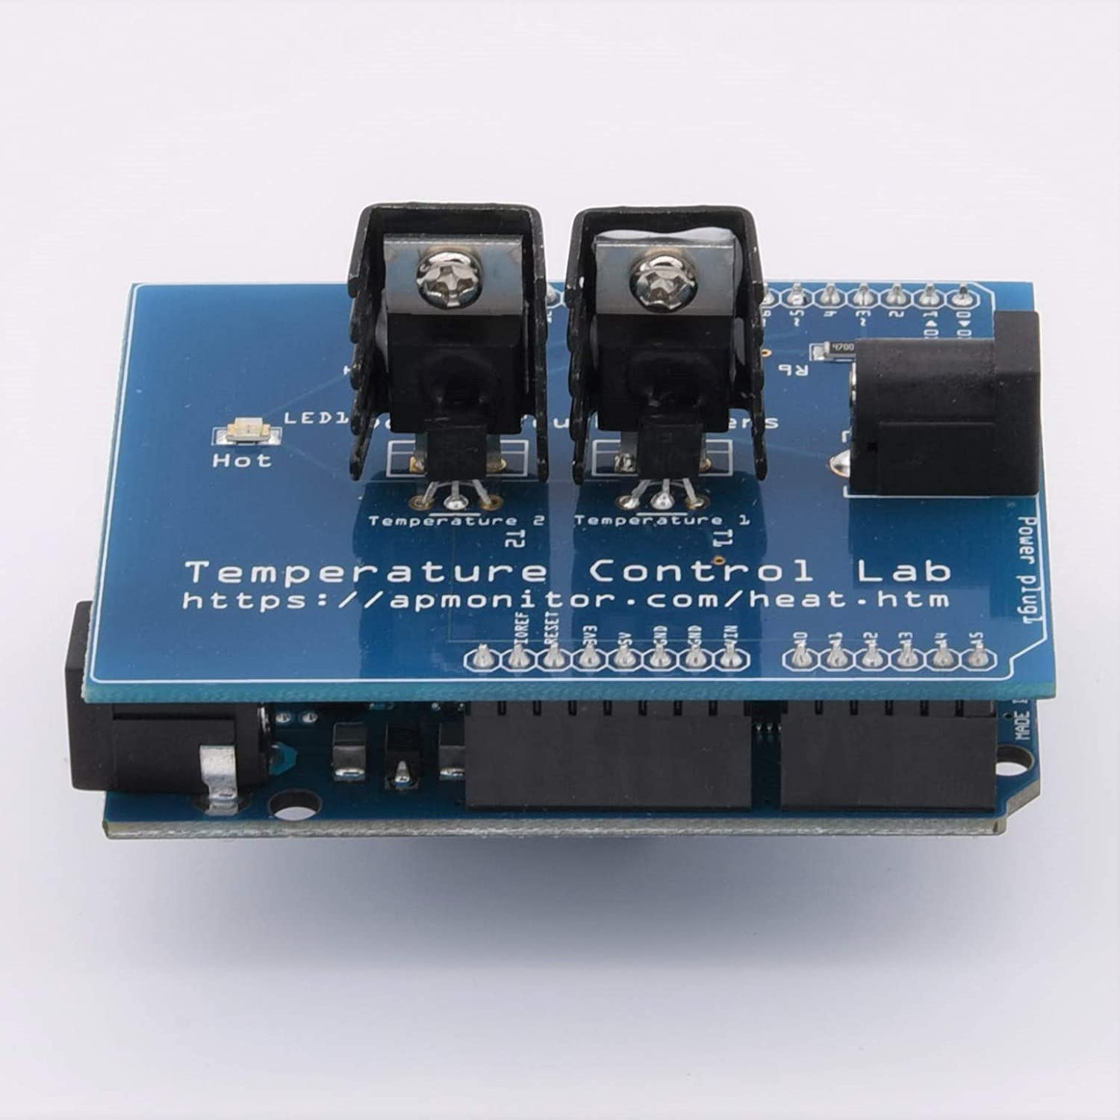
Process Presentation
Heater(Actuator)
Sensor
(TMP36)
0-5V
Input (0-100%)
Temperature(°C)
TCLab Process

Slide 3



System Identification & Control
TCLab Process
error
ISE Criterion
First Ordre Plus Dead Time System
+
-
Step test
$τ\frac{dy(t)}{dt}=−y(t)+k∗u(t−θ$)
k , $τ,θ$
Particle Swarm Optimization
Identification
Control
Output
(Heater temperature)
Control signal
Set Point
error
IMC-Based PI
Saturation
+
TCLab Process
-
On/Off
Integral action
Anti-Windup
Clamping Algorithm

Slide 4
APPENDIX

Slide 5

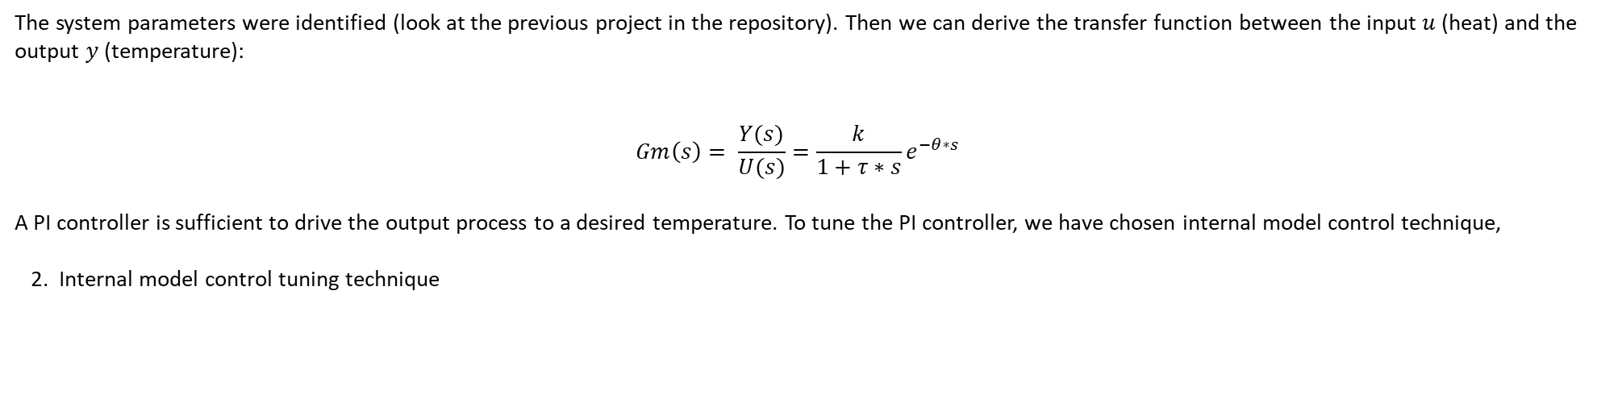






Proportional integral controller tunning using Internal model control method calculation
1. System Model
Our system is modeled as a first order plus dead time, it can be written as follows :
$τ\frac{dy(t)}{dt}=−y(t)+k∗u(t−θ$)
The system parameters were identified (look at the previous project in the repository). Then we can derive the transfer function between the input $u$ (heat) and the output $y$(temperature):
$$Gm\left(s\right)= \frac{Y(s)}{U(s)}=\frac{k}{1+τ∗s}e^{−θ∗s}$$
A PI controller is sufficient to drive the output process to a desired temperature. To tune the PI controller, we have chosen internal model control technique,
2. Internal model control tuning technique
r
e
u
y
r
e
$${Gc(s)}^{∗}$$
u
y
+
$$F(s)$$
$$Gc(s)$$
$$Gp(s)$$
+
$$Gp(s)$$
-
-
ym
+
Résultats : Diapositive suivante
$$Gm(s)$$
-

Slide 6


Proportional integral controller tunning using Internal model control method calculation
To calculate the IMC controller, it is convenient to break our system model into two parts, the first one contains proper form of transfer function, the second one holds improper transfer function,ie: zeros dynamics :
Firstly we have :
$$Gm\left(s\right)= \frac{Y(s)}{U(s)}=\frac{k}{1+τ∗s}e^{−θ∗s}$$
This transfer function carries a time delay that can be approximated using zero-order Padé approximation :
$$e^{−θ∗s}=1−θ∗s$$
So the final expression of the model transfer function after being simplified is :
$$Gm\left(s\right)=\frac{k∗(1−θ∗s)}{\left(1+τ∗s\right)}$$
A decomposition of $Gm$ as stated above yields :
$$Gm\left(s\right)= {Gm(s)}^{−}∗{Gm(s)}^{+}$$
Such that :
$${Gm(s)}^{−}=\frac{k}{\left(1+τ∗s\right)} and{ Gm(s)}^{+}=(1−θ∗s)$$

Slide 7
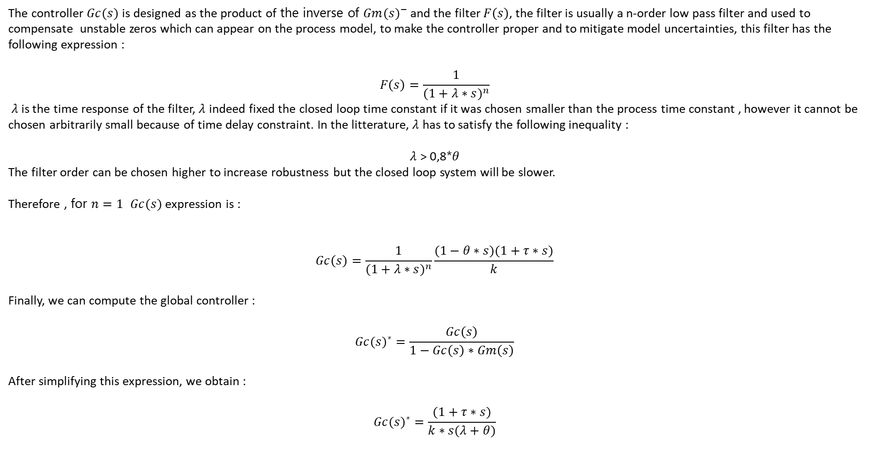
Proportional integral controller tunning using Internal model control method calculation
The controller$Gc(s)$ is designed as the product of the inverse of ${Gm(s)}^{−}$ and the filter $F\left(s\right)$, the filter is usually a n-order low pass filter and used to compensate unstable zeros which can appear on the process model, to make the controller proper and to mitigate model uncertainties, this filter has the following expression :
$$F\left(s\right)=\frac{1}{{(1+λ∗s)}^{n}}$$
$λ$is the time response of the filter, $λ$ indeed fixed the closed loop time constant if it was chosen smaller than the process time constant , however it cannot be chosen arbitrarily small because of time delay constraint. In the litterature, $λ$ has to satisfy the following inequality :
$λ$ > 0,8*$θ$
The filter order can be chosen higher to increase robustness but the closed loop system will be slower.
Therefore , for $n=1$ $Gc(s)$ expression is :
$$Gc\left(s\right)=\frac{1}{{(1+λ∗s)}^{n}}\frac{(1−θ∗s)(1+τ∗s)}{k}$$
Finally, we can compute the global controller :
$${Gc(s)}^{∗}=\frac{Gc\left(s\right)}{1−Gc\left(s\right)∗Gm\left(s\right)}$$
After simplifying this expression, we obtain :
$${Gc(s)}^{∗}=\frac{(1+τ∗s)}{k∗s(λ+θ)}$$

Slide 8
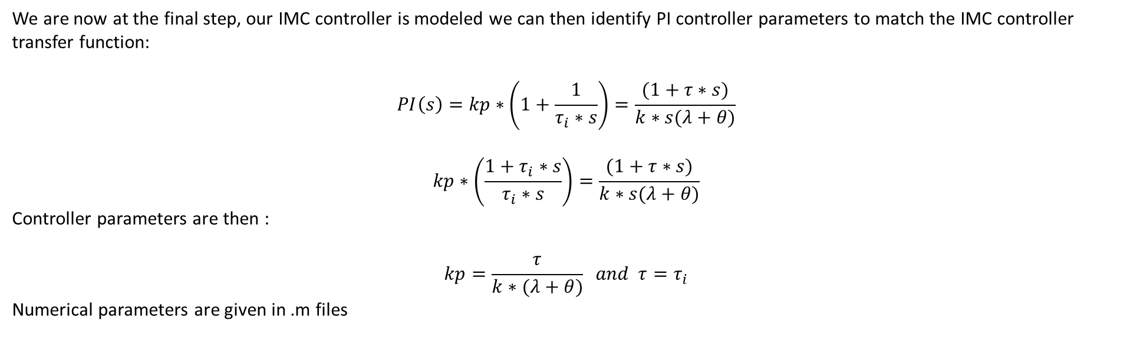
Proportional integral controller tunning using Internal model control method calculation
We are now at the final step, our IMC controller is modeled we can then identify PI controller parameters to match the IMC controller transfer function:
$$PI\left(s\right)=kp∗\left(1+\frac{1}{τ_{i}∗s}\right)=\frac{(1+τ∗s)}{k∗s(λ+θ)}$$
$$kp∗\left(\frac{{1+τ}_{i}∗s}{τ_{i}∗s}\right)=\frac{(1+τ∗s)}{k∗s(λ+θ)}$$
Controller parameters are then :
$$kp=\frac{τ}{k∗(λ+θ)} and τ=τ_{i}$$
Numerical parameters are given in .m files

Slide 9
Results

Slide 10
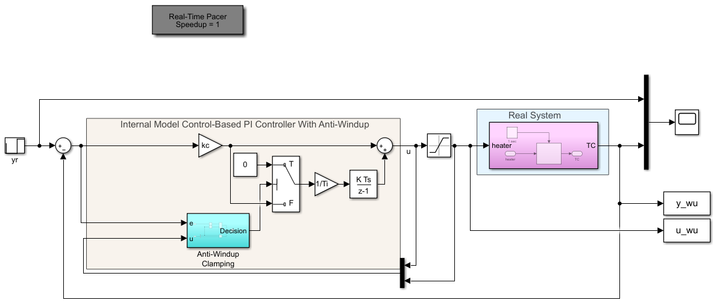
Results

Slide 11
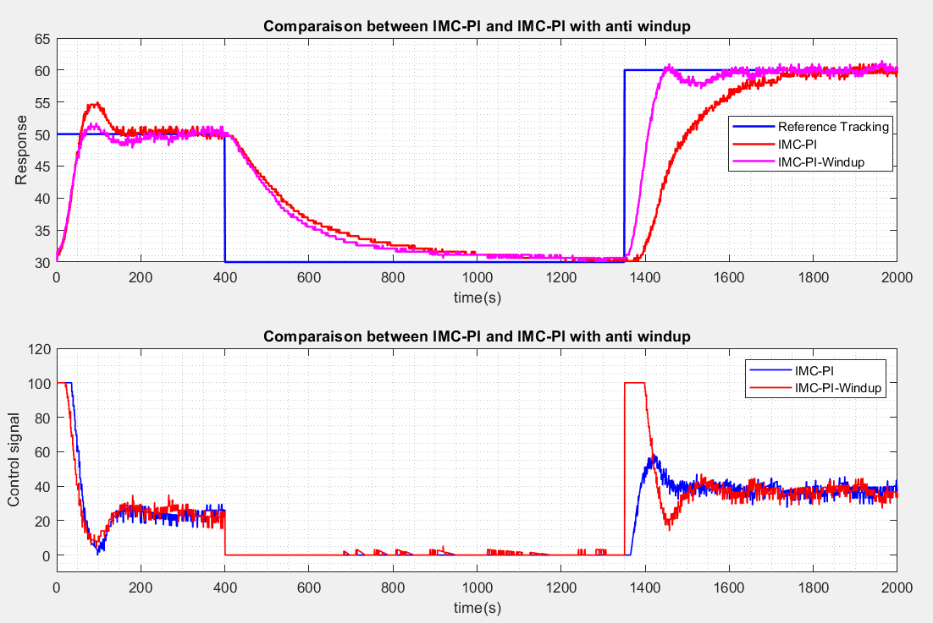
Results

Slide 12
END

